Slide 1
Effect of stop skipping on passenger travel time on the Washington Metro
By: Anoop Hariharan

Slide 2
Abstract
The subway is an essential form of transportation in densely populated cities. However, it is often slower and less efficient than other modes of transport because of the numerous stops made. A solution to this issue is the use of an AB skip stopping system, which allows trains to skip certain stops so that passengers can reach their destination faster. This project aims to use a continuous approximation model developed in Chile (Freyss et. al, 2013) with the Washington Metro system in order to predict the effect of a skip stopping system on travel cost. This model makes it faster and less expensive for officials to determine if a skip stopping system would be useful for their city.

Slide 3
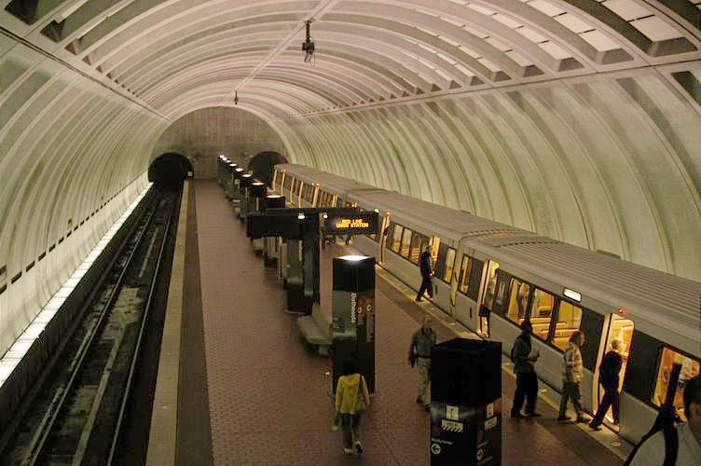
Problem
How can a model be devised that predicts the effectiveness of skip stopping on a metro system quickly and at minimal cost?
Image Source: http://bit.ly/2z2aqIj

Slide 4
Purpose
Research the effects of a skip stop system on the Washington Metro using a continuous approximation model developed by (Freyss et. al, 2013).

Slide 5
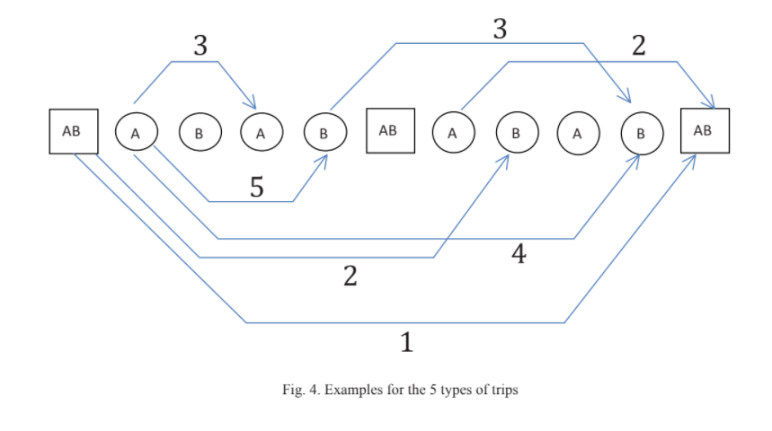
Conceptual Outline-Introduction to Stop Skipping (graphic)

Slide 6
Model Overview
I will be using a stop skipping model developed by (Freyss. et al) in Chile and applying it to the Washington Metro.
This model is a continuous approximation model (can operate on non-integer inputs and output non-integer values.)
More practical than to do a discrete optimization for the AB stations.

Slide 7
Constants for cost functions (for Washington Metro Silver Line)
λ: station density [Stations/m]= .0005879
N: number of passengers per unit of time starting a trip in each station [pax/s]= 0.1202296
Calculated from data file
nT: number of trains operating in each direction- filing a records request for this information
vl: cruising speed of the subway [m/s]= 14.7523
ts: dwell time in every station [s]= 30

Slide 8
Cost Function- Conceptual Overview
Model has two cost functions: one for normal operation and one for skip stop operation.
These cost functions are a sum of different costs, including travel cost, waiting cost, and transfer costs. Future costs to be added include traction cost and cruising speed costs.
Standard operation is not dependent on an input variable while skip stop operation is dependent on AB station density.

Slide 9
Cost Function- Equation

Slide 10
Different types of trips under a skip stop operation

Slide 11
Project workflow
Step 1
Step 2
Step 3
Step 4
Source data about metro operations from the Washington Metro using publicly available online sources. This data includes number of stations, track length, and fleet size.
Excluding the parameters about energy, program the various functions of the continuous approximation model into Python Spyder
After identifying the optimal AB station density in the current model, find the cost of the skip stop operation at that density and compare it with the calculated normal operation cost.
Add additional parameters to the model, and extend it to a multivariate function (possibly utilizing neural networks) with boundary constraints for a reasonable train operation.

Slide 12
Work accomplished until Progress Report 1
Downloaded ridership dataset from WMATA
Contains information about what destinations passengers take from each destination.
Understood premise of the continuous approximation model
The different types of trips under a skip stop operation, and why a skip stop operation can increase waiting.
Started to program some of the functions into Python

Slide 13
Work accomplished thus far
Sourced parameters for Washington Metro
Train cruising speed, dwell time etc.
Contacted WMATA for information
Received an initial reply for more specification on the data I was seeking, but no replies after that (sent a follow up email).
Programmed entire skip stop model into Spyder and Jupyter Notebook
Excluded energy cost function for now
Model is working as in the paper except for transfer cost due to certain parameters which I need more information on.

Slide 14
Work accomplished thus far (cont.)
Generated a graph of the cost function using the py.plot library
Seems to be matching with the ideal graphs given in the paper, indicating that at least the variables in the function are correct.
Ran sci.py optimize on the travel cost function to find the minimizing AB station density
Identified variables that could be implemented into the multivariate function

Slide 15
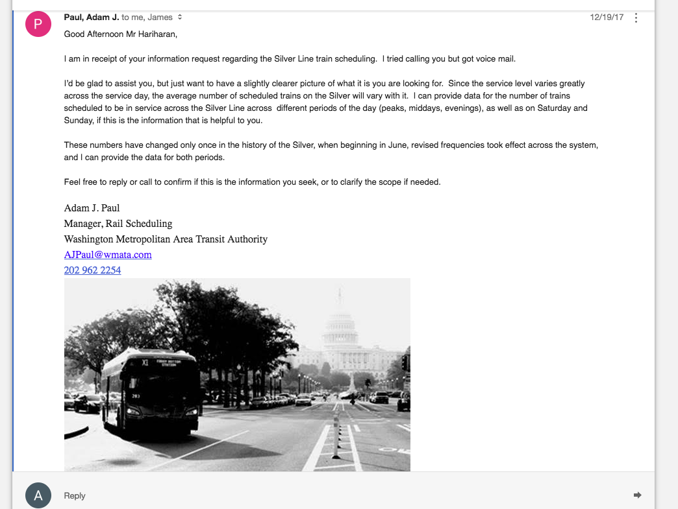
Emails

Slide 16
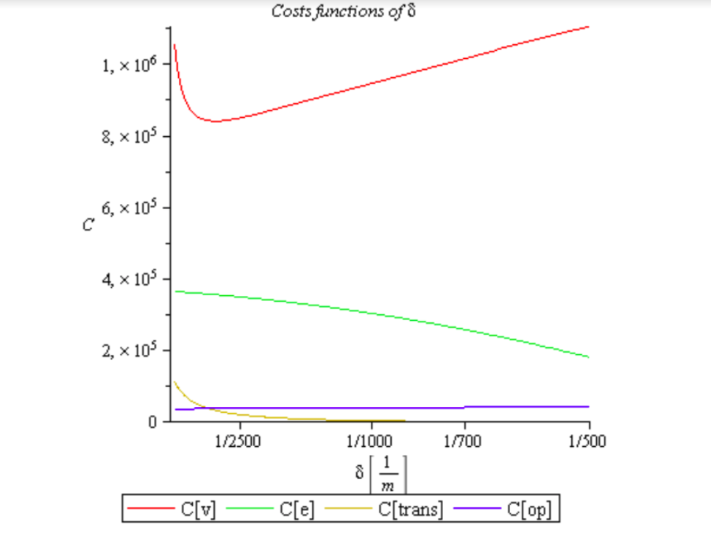
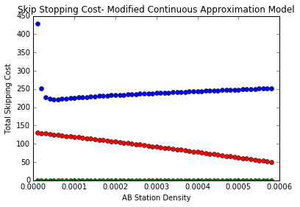
Generated Graphs and Graphs in paper
Total travel cost
Total travel cost
Total waiting cost
Total waiting cost
Transfer cost (in progress)
Notes:
Focusing only on transfer and waiting cost for right now

Slide 17
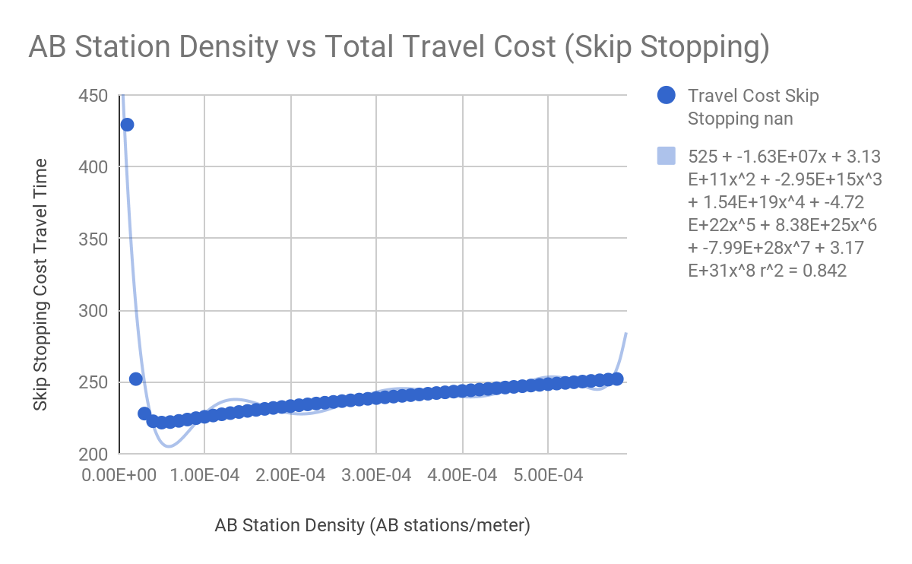
Cost functions- regressions cannot approximate
Notes:
The function can’t be solved automatically

Slide 18
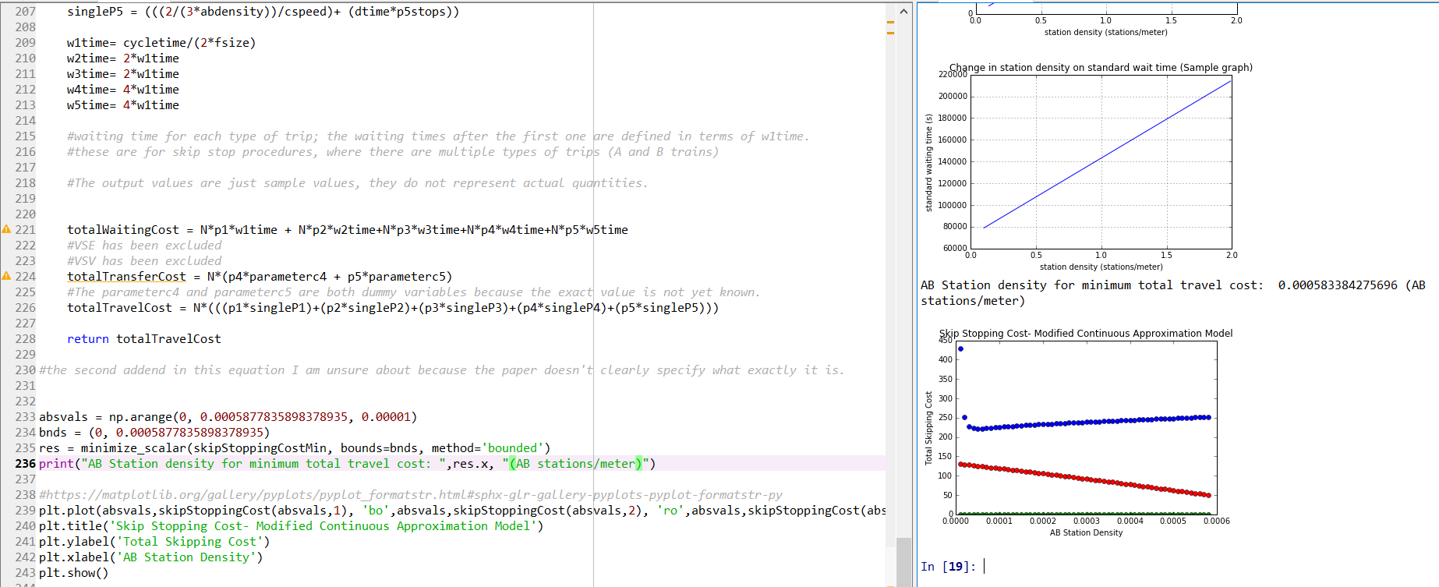
Code Sample

Slide 19
Future Work
Multivariate optimization
Possible variables that are used in the paper for sensitivity analyses: fleet size, line length, initial station density.
Convert existing function into a multivariate function and use sci.py optimize on it with bounds so that the values are realistic for a metro system.
Addressing drawbacks to this model and including custom functions
Major assumptions like passenger demand is distributed equally across all stations, have infinite capacity, and equal dwell times at all stations.
Note: Passenger demand assumption tends to benefit skip stopping system
Including a time of day component to the model
This would address the changes in operations and passengers in peak/off peak times.
Help understand if using skip stopping at certain times could be beneficial rather than considering it as all or none.

Slide 20
References
Freyss, M., Giesen, R., & Muñoz, J. C. (2013). Continuous approximation for skip-stop
operation in rail transit. Transportation Research Part C: Emerging Technologies, 36,
419-433.
Vuchic, V. R. (1976). Skip-stop operation: High speed with good area coverage. UITP Revue,
114.

